Slide 1
CREATING AND DEPLOYING WORDPRESS USING JENKINS , DOCKER-COMPOSE AND AMAZON RDS
Project-ii
Y.DEEPTHI JAN-18
8AM BATCH

Slide 2
AGENDA
Introduction
Primary Goal
Pre-Requisites

Slide 3
Introduction
WordPress is a content management system that allows you to host and build websites. WordPress contains plugin architecture and a template system, so you can customize any website to fit your business, blog, portfolio, or online store.

Slide 4
PRIMARY GOAL
Deploying WordPress application ,it can be done using different methods
Jenkins
Docker-Compose
Amazon RDS

Slide 5
PREREQUISITES
AWS Account
GitHub Account
Knowledge of Docker, Docker-compose
Knowledge of Jenkins ,AWS services

Slide 6
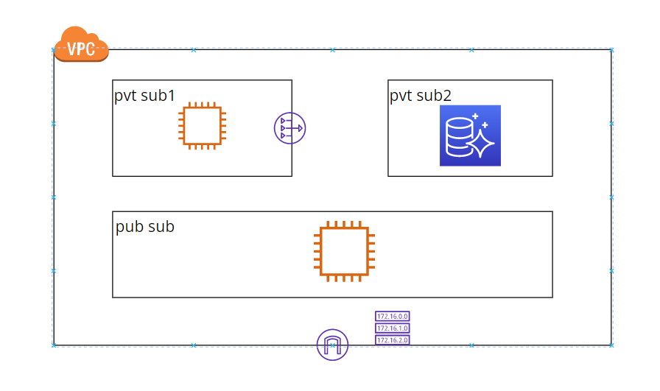
USING AMAZON RDS
ARCHITECTURE

Slide 7
STEPs
Create AWS resources as shown in architecture
Install all dependencies for WordPress application(MySQL and php).
Install httpd start and enable httpd.
Copy all WordPress files in /var/www/html
Configure wp-config.php file with credentials of MySQL server created in AWS.

Slide 8
WordPress installation using Jenkins
JENKINS:
Jenkins is an open source automation server. It helps automate the parts of software development related to building, testing, and deploying, facilitating continuous integration and continuous delivery.

Slide 9
STEPs
Install Jenkins and java on instance created
Give permissions to Jenkins user to execute shell commands and sudoers permission
Create free style job in Jenkins
In build steps add execute shell through shell scripting download all dependencies
Import all WordPress files from GitHub in the location /var/www/html.
Now build the job WordPress will be automatically deployed on the server

Slide 10
WORDPRESS DEPLOYMENT USING DOCKER-COMPOSE
Docker-Compose:
Compose is a tool for defining and running multi-container Docker applications. With Compose, you use a YAML file to configure your application's services

Slide 11
STEPS
Install docker and docker compose in the instance
Create project folder and add docker-compose.yml file in the directory.
Create two directories for volumes so that data can be persistent in case containers get removed for any reason.
Now run the compose file using command docker-compose up &

Slide 12
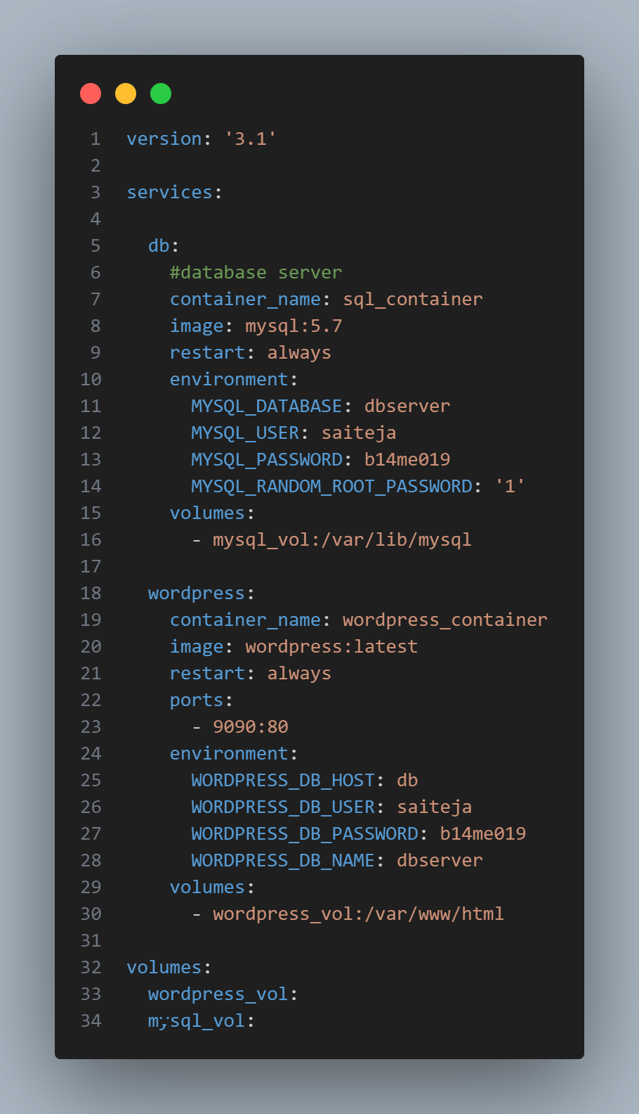

Slide 13
THANKYOU

